Slide 1
Creative Solutions for Student Exhibitions
March 27, 2020

Slide 2
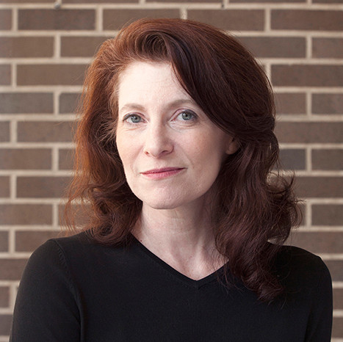
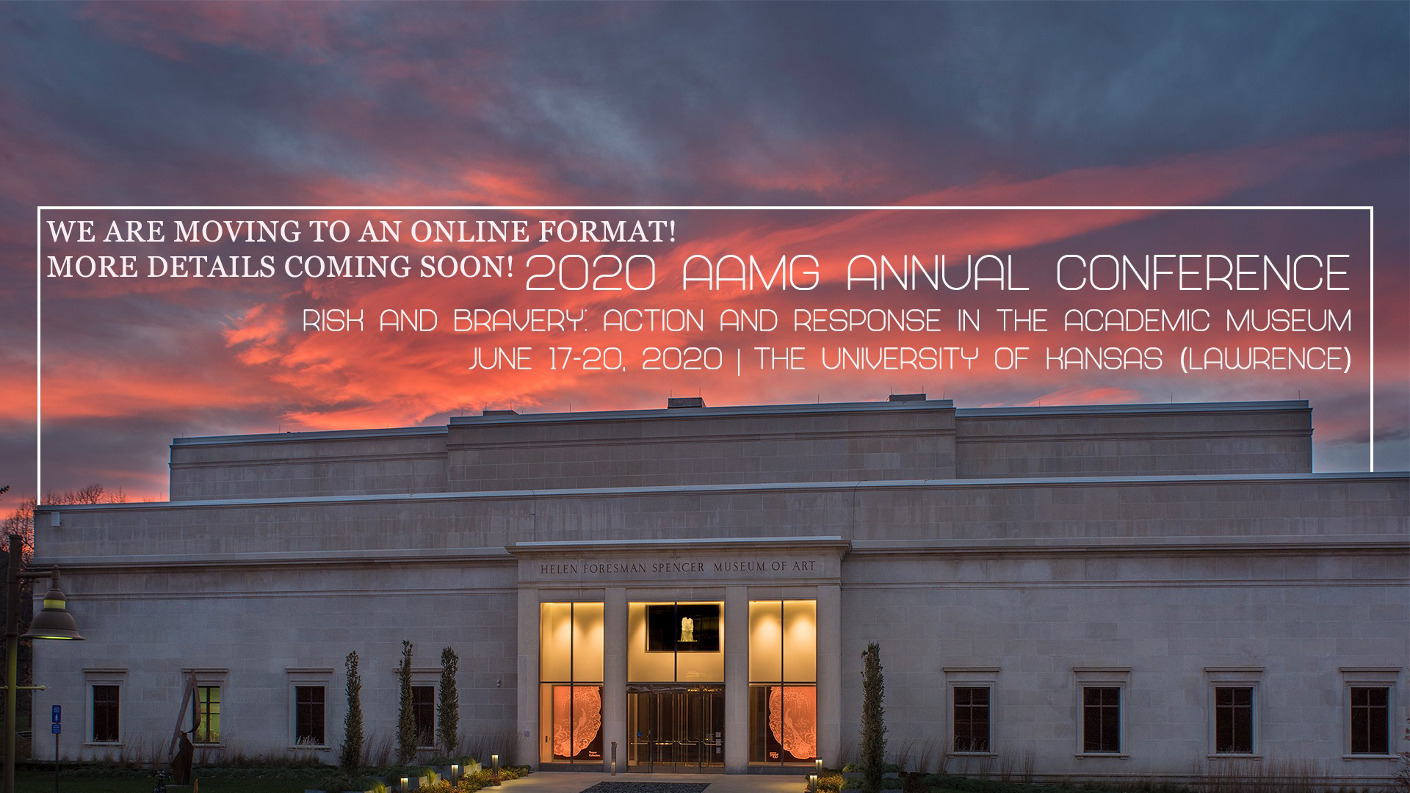
2020 Annual Conference
Tracy Fitzpatrick
Vice President of Programs
More online: aamg-us.org

Slide 3
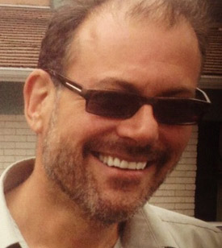
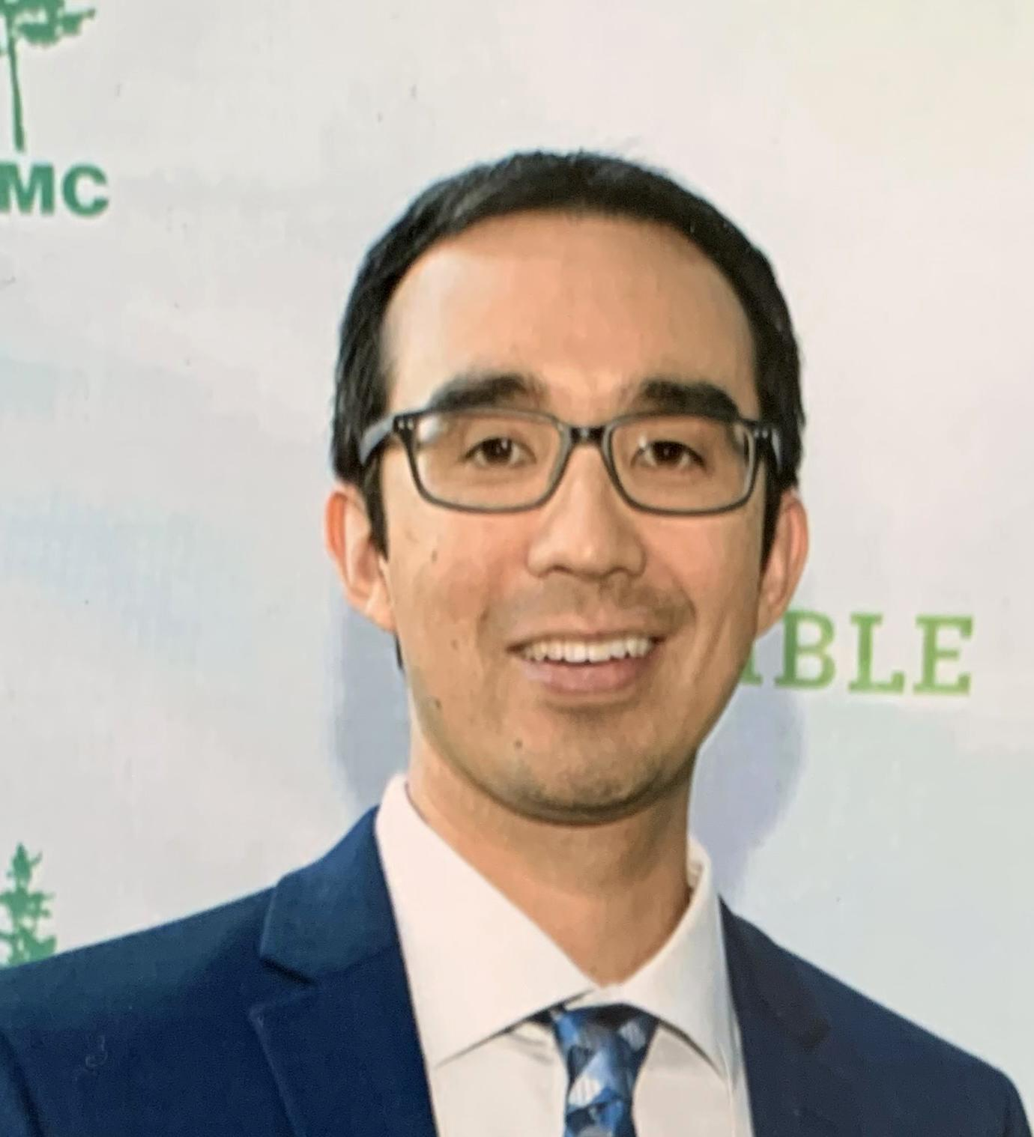
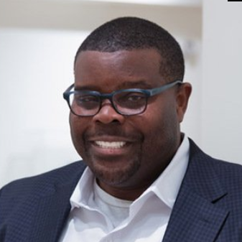
Your Presenters Today
Alexandra Chamberlain Gabriel Harrison Craig Hadley Jamaal Sheats
“How is your institution responding to student exhibitions and graduation requirements in light of COVID-19?”
Indiana State University Stanford University Northwestern Michigan College Fisk University

Slide 4
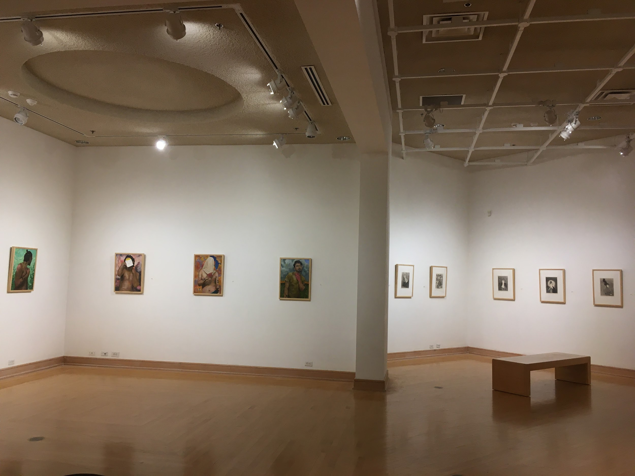
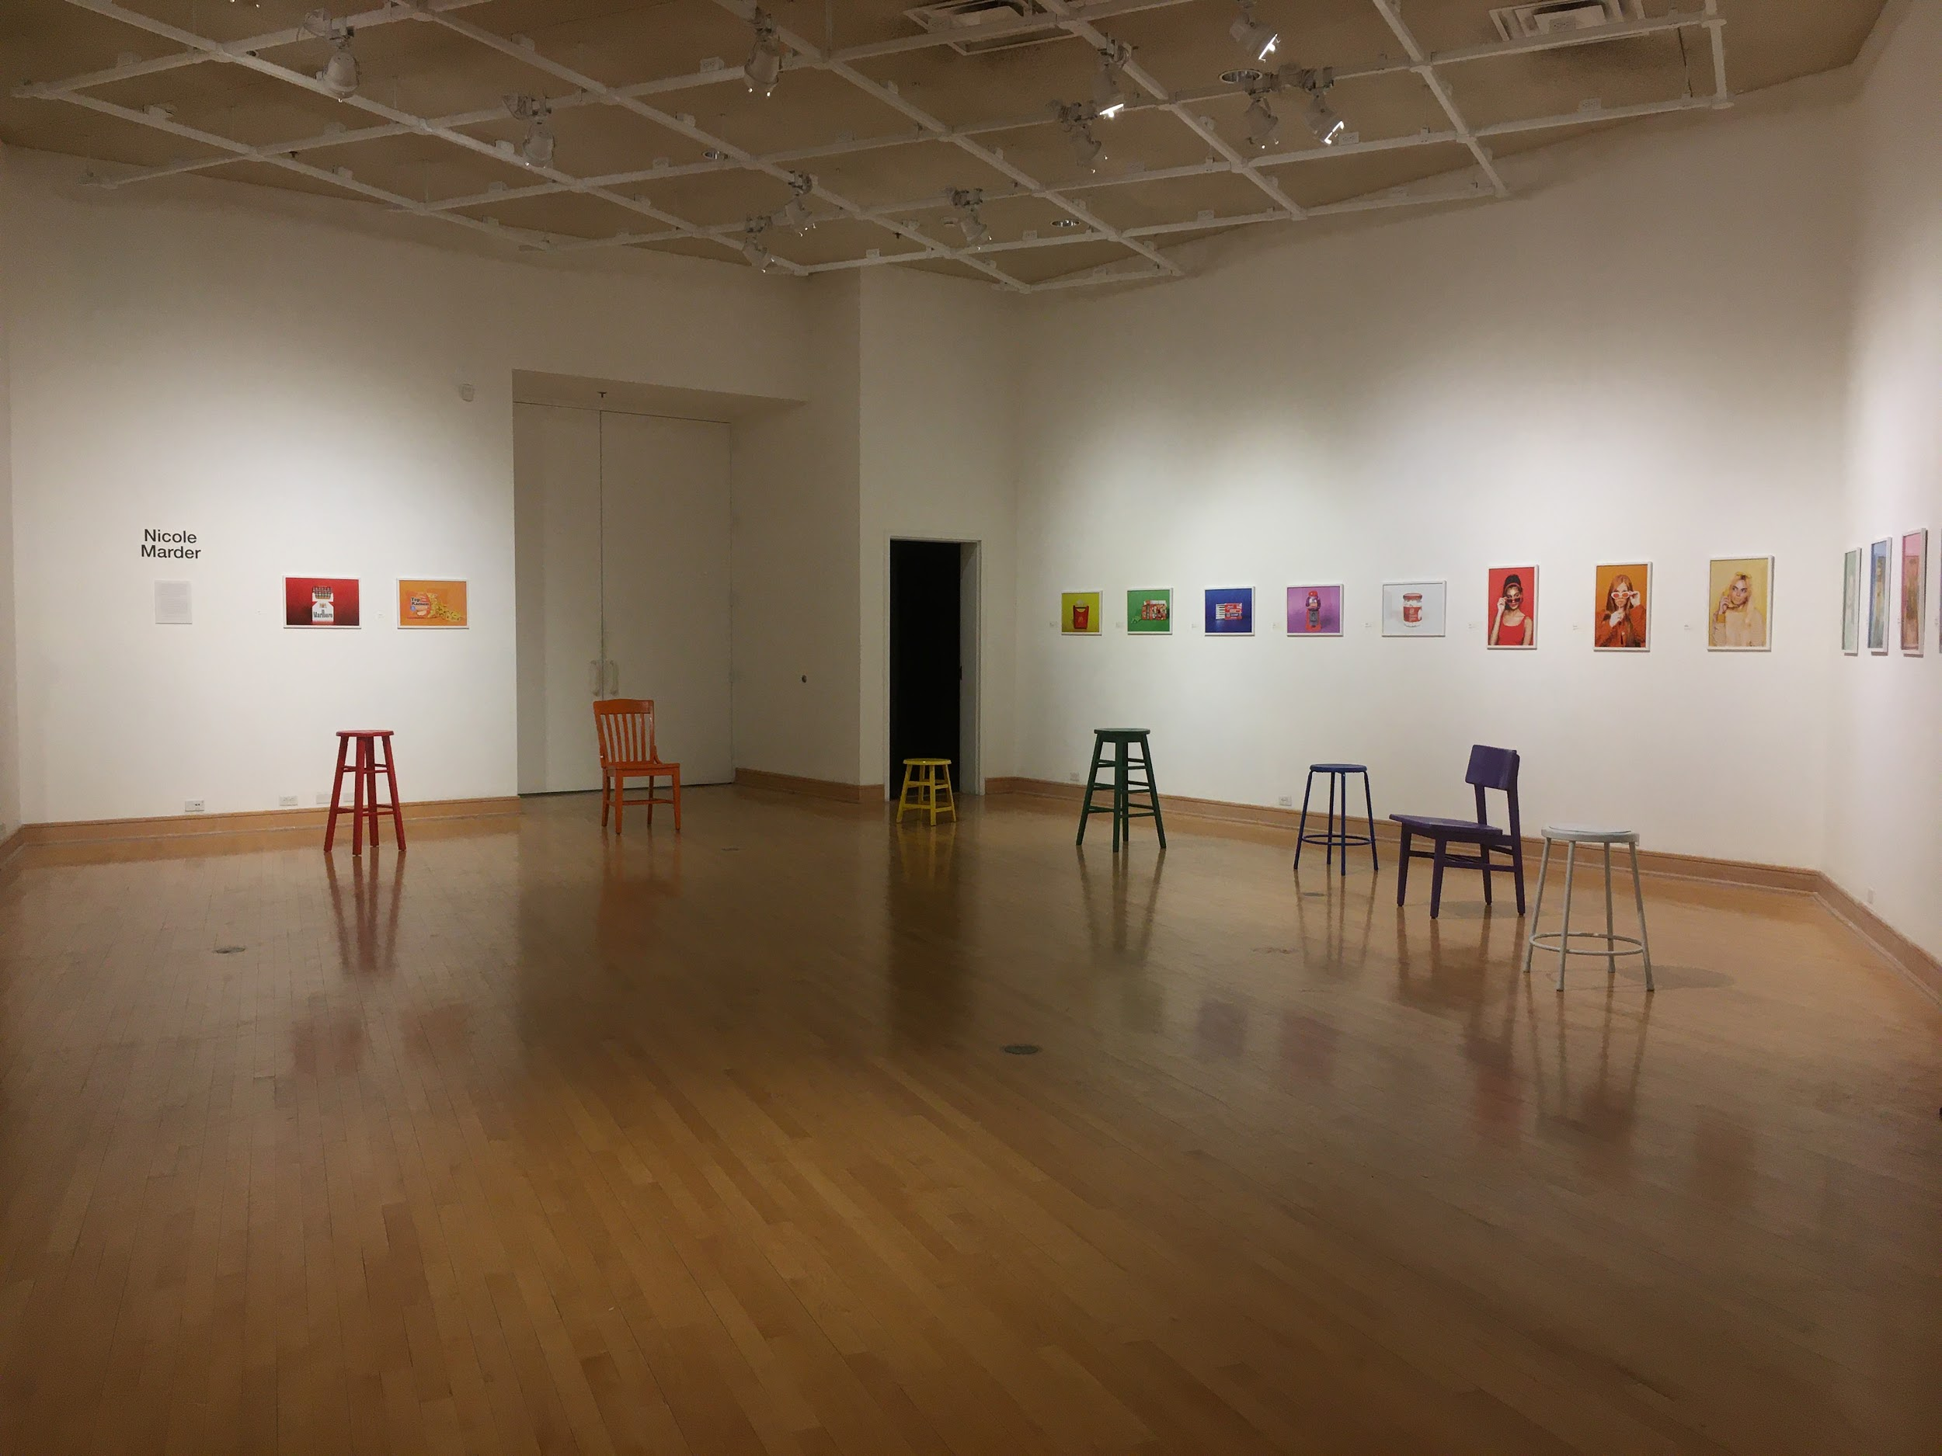
Alexandra Chamberlain
Gallery Director and Instructor
Indiana State University Galleries
Structure:
Every Semester the University Art Gallery Hosts
MFA Thesis Exhibition (from 3-10 students)
BFA/BA Senior Exhibition (from 10-25 students)
This Semester
Installed MFA (3 students) but could not host opening reception
Currently still installed in the gallery
Must move BFA/BA Senior Exhibition to online format
Staffing:
Gallery Director who is also faculty teaching two full semester courses (working from home)
Reports to Chair of the Department of Art and Design
Faculty Status-non tenure track
Gallery Assistant
allotted only 15 hours a week
approved to work from home
Staff
Three Student Workers (Spring 2020)
All were required to leave campus and not given option to have them work from home

Slide 5
Indiana State University cont.
Timeline of events:
March 12: President Curtis announces “We will begin online instruction only beginning March 16, Spring Break is the next week, and then we will have two more weeks of online only instruction following Spring Break”
March 13: I was directed by the chair of the department that exhibitions would still be taking place, however, opening receptions would be cancelled for the remainder of the semester
March 16: President Curtis announces “Online only instruction will extend to the rest of the semester; Residence halls will close at noon this Saturday (March 21); We will be canceling our spring commencement ceremony; THE UNIVERSITY IS STILL OPEN!”
March 17: I was told by the chair of the department that “All campus events and ceremonies, including commencement, performances, exhibitions and their openings, Honors Night are canceled.
March 18: I ask our Gallery Assistant to start researching best platforms and strategies to host an online exhibition of sorts
Note: many of our students do not have access to Internet, taking images of their final works, let alone the equipment necessary to completing their final works...

Slide 6
Indiana State University cont.
Timeline of events cont.
March 18-March 25
Gallery Assistant, and myself have been following the online conversations from you all, and creating our own lists of best options for our needs and the capabilities of our students
Had decided that best option given the circumstances and the constraints that many of our graduating students are facing as well as the limits of my own technological capabilities, would be to create a Squarespace site that we could direct friends, family, etc. to on a wide ranging capacity.
March 25
I reach out to our finance administrative assistant and inquire about purchasing website domain and/or accessing another platform that may either cost or be free
FULL STOP
“Any online presence must be on the University website and servers”
Now I had assumed that I wouldn’t be able to create a wholly new website, HOWEVER I did not think that I would be kept from even trying out other platforms EVEN IF THEY WERE FREE OF CHARGE
ONLY OPTION
Use Indiana State Website (Drupal) with plugin to YouTube for animated/video content

Slide 7
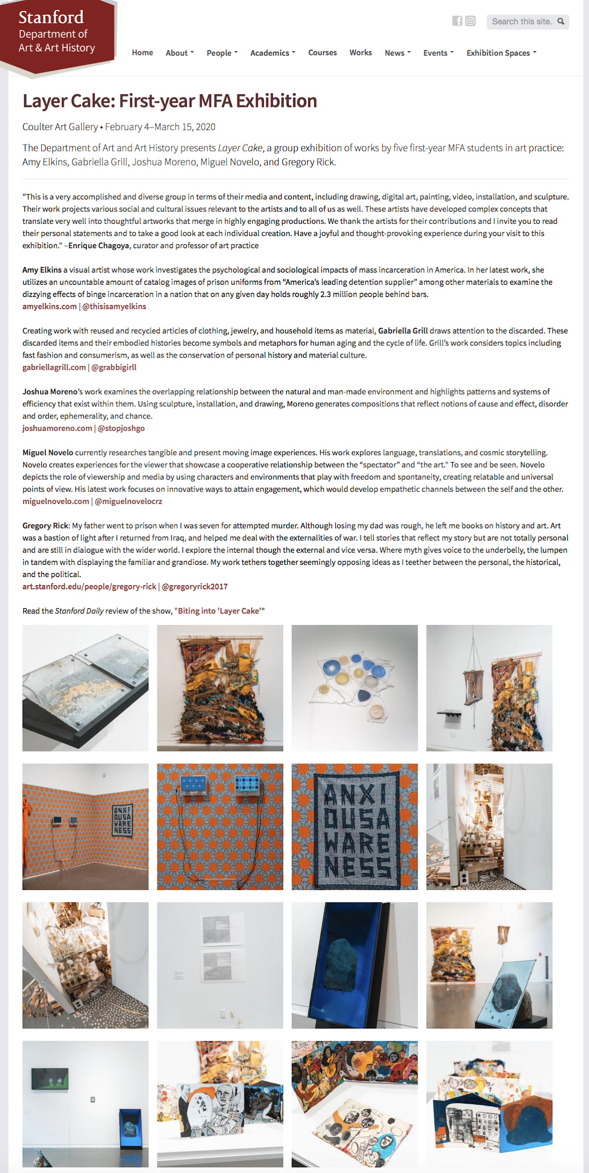
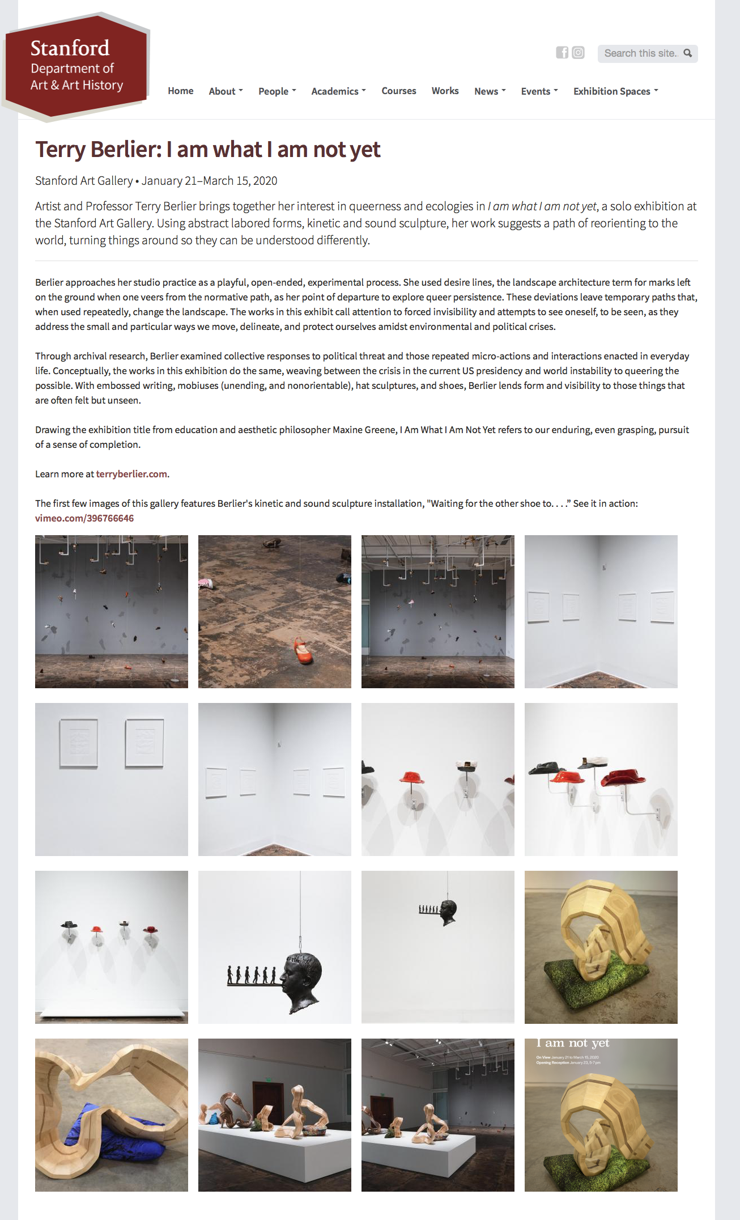
Gabriel Harrison
Galleries & Exhibitions Manager, Stanford University
March 7th: Winter Quarter
Stanford Art Gallery and Coulter Art Gallery are run by the Department of Art & Art History. Along with the Anderson Collection and the Cantor Arts Center, which are independent museums on the campus, they close to the public and the school itself begins closing down.
Our Events and Communications Manager puts the two main exhibitions online immediately, using only existing web tools at hand.

Slide 8
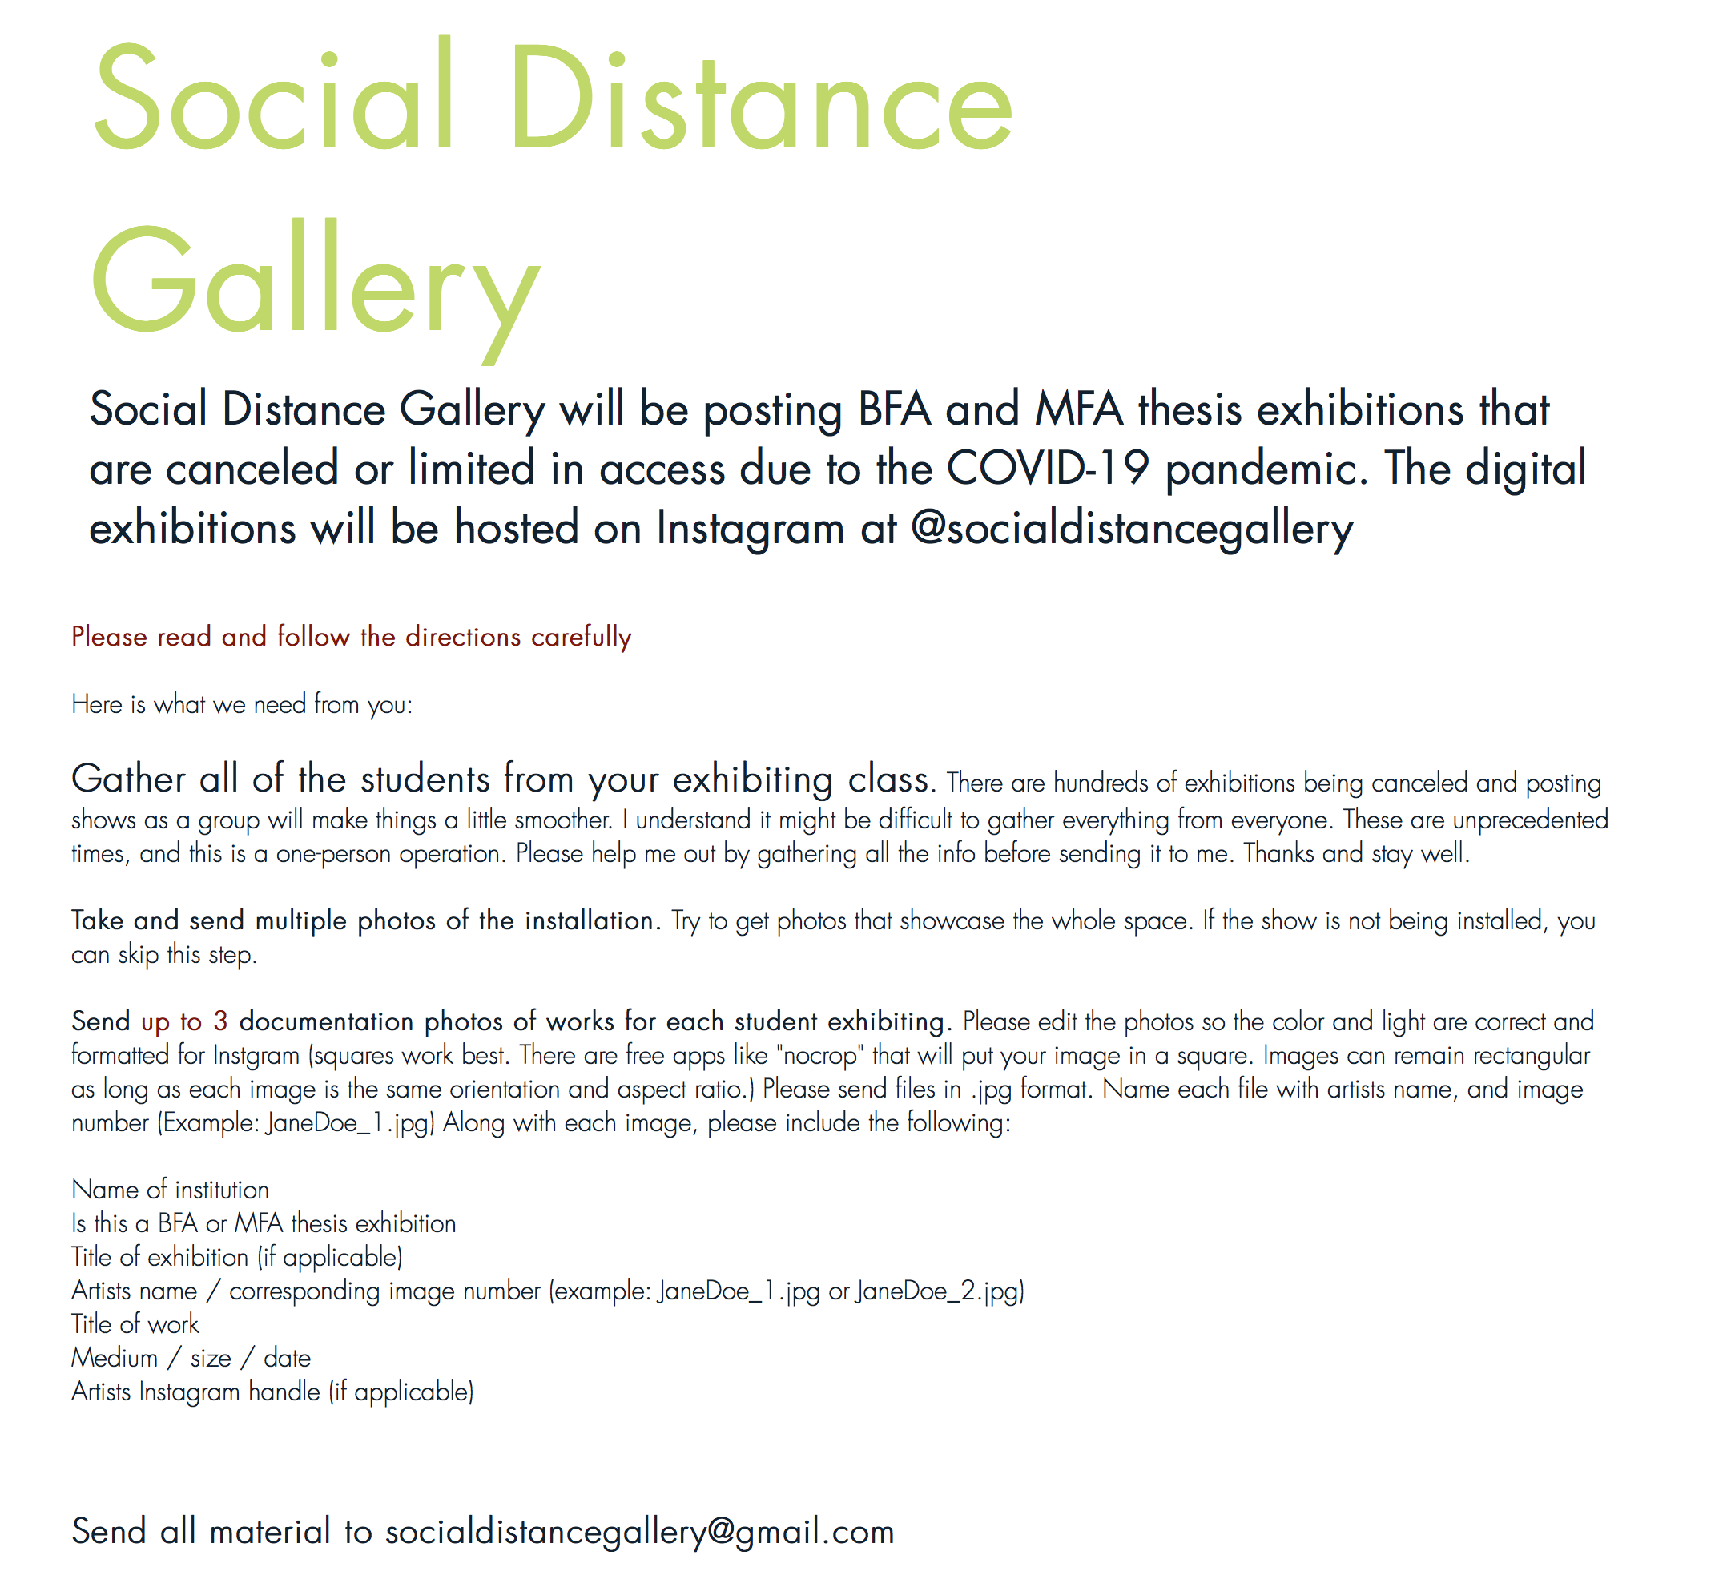
Stanford University cont.
March 15th: Winter Quarter
It begins to dawn on us that we’re in this for the long haul. And we start to look at the spring exhibition schedule.
Typically we install the Honor’s Exhibition and the Senior Exhibition in the Coulter Gallery and the MFA Thesis Exhibition in the Stanford Art Gallery, as well as class exhibitions in the five smaller gallery spaces.
Researching with our preparator who does a deep dive, it seemed that responses break into two types:
Online images of work in the gallery spaces and/or discrete works placed onto institutional websites, as well as works pushed out through Instagram and other social media platforms. Independent online galleries are helping (Social Distance Gallery, for example).
Virtual tours through gallery spaces for those with collections and larger resources, typically museums, and typically at high cost.

Slide 9
Stanford University cont.
Spring Break
Our goal from the beginning was to replicate as best as we could the curatorial experience that we give the students, to recreate the process of placing their work in a physical space and in direct dialogue with other works.
We already used Sketchup as a design tool to layout and organize the work either directly, or as a supplement to curating in the space with the students. But our existing models were basic and only used internally.
So, we began to investigate the program possibilities and finally settled on the tool we were already familiar with, Sketchup.
We’re still looking at how to embed student videos directly into the model. But at least they can be loaded onto the website at the moment.
Through trial and error we found that we could hold a virtual meeting using Zoom and then involve the students in moving the work around in the virtual model in real time. This would engage them in the curatorial experience with us.
Through a bit of research we discovered that we could create a simple walk-through, lock it, and place it on our website with a reader so that anyone could take a virtual walk through of the space.

Slide 10
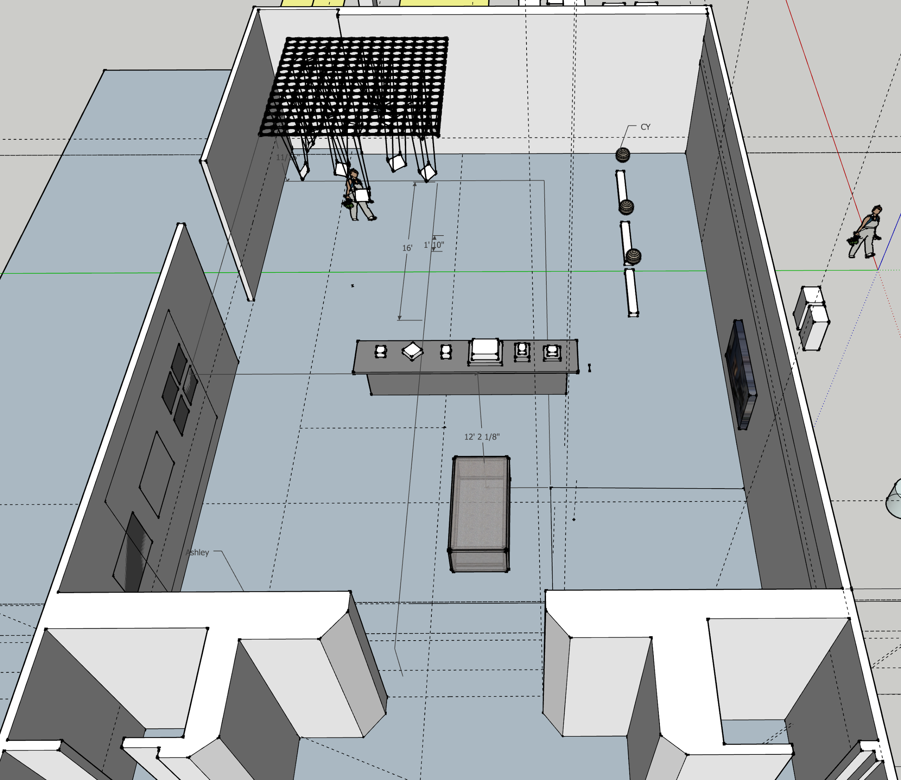
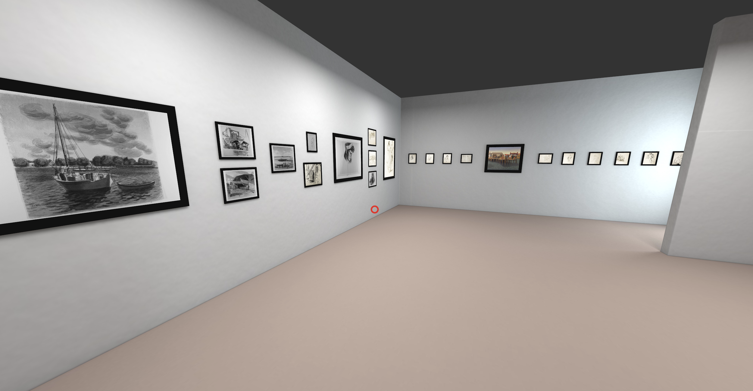
Stanford University cont.
Spring Quarter:
We’ll take our existing rough models that we use as design and layout tools (as seen on the left) and bring them up to a higher level of finish (as this one on the right, which was borrowed from UC Santa Cruz’s Sesnon Gallery).
Our Events and Communications Manager is working on website upgrades, both aesthetically and functionally, as we work together to put this online with other material from the exhibition program.
Our MFA Thesis Exhibition may move to the fall quarter and still be realized in the Stanford Art Gallery, but our current plan is to combine the Honor’s and Senior Exhibitions into a single Spring show at the Coulter Art Gallery and curate them virtually with the students. The biggest challenge will be taking 3D work that students may do at home, creating models of them based just on photographs, and placing them into our gallery model.

Slide 11
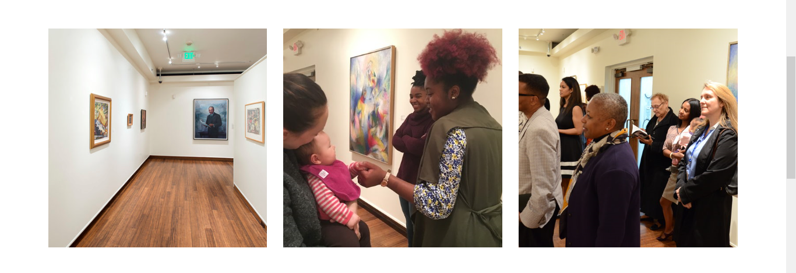
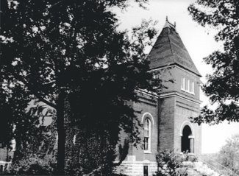
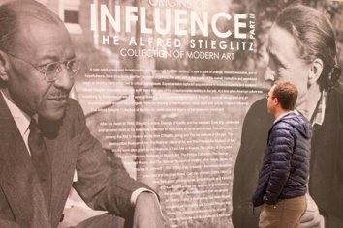
Jamaal Sheats
Director, Fisk University Galleries
4,000-object permanent collection, including the Alfred Stieglitz Collection of Modern Art and gifts from Abby Aldrich Rockefeller, the Harmon Foundation, Lincoln Kirstein, and Rockwell Kent​
Two galleries: Carl Van Vechten Gallery and Aaron Douglas Gallery ​

Slide 12
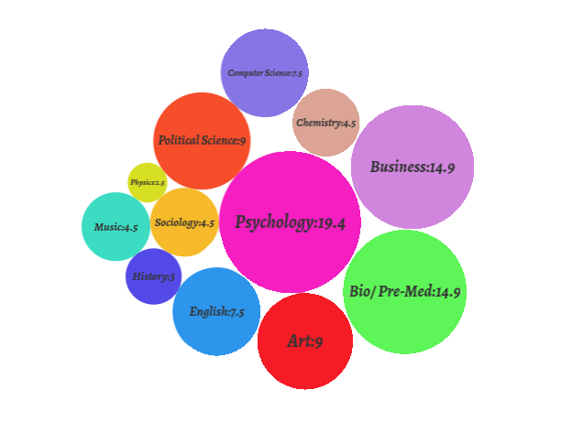
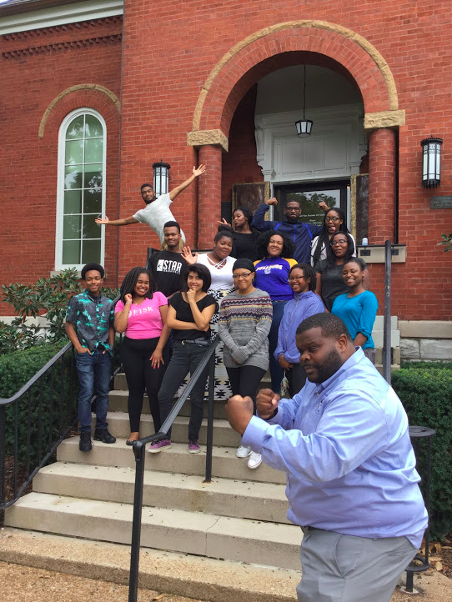
Jamaal Sheats
Director, Fisk University Galleries

Slide 13
Discussion
We will begin with moderated discussion questions from our Google survey
*Use the Zoom chat function to send additional questions to us*
Continue this conversation online afterwards on the AAMG Listserv!

Slide 14
Thank you
Stay tuned for additional webinars and 2020 Annual Conference details!
aamg-us.org

